Slide 1
Introducing The SHINE Trial (Stroke Hyperglycemia Insulin Network Effort)
An Overview for Clinical Nurses
NIH-NINDS U01 NSO69498

Slide 2
Background
Hyperglycemia during acute stroke associated with worse outcome (both morbidity and mortality)
Hypoglycemia bad for ischemic brain
Glucose control in acute ischemic stroke patients shown to be feasible and safe (GRASP trial and THIS trial)
Stroke community deals with hyperglycemic acute stroke patients every day without evidence on what is best

Slide 3
Objective
To assess the efficacy and safety of glycemic control (80-130 mg/dL) using insulin infusion with decision support tool versus standard control (<180 mg/dL) using sliding scale and basal insulin in hyperglycemic acute ischemic stroke patients

Slide 4
Overview
~60 sites, 1400 pts over 3.5-4 years
Single blind treatment (patient/family will NOT know but clinical/study team will know)
Ischemic stroke pts <12 hr window from symptom onset
Pts w/ history of type 2 diabetes & glucose >110 mg/dL OR glucose ≥150 mg/dL in those w/o known diabetes
Treatment groups
Control – Saline drip & SQ sliding scale insulin (target BG <180 mg/dL)
Intervention - Insulin drip & SQ meal insulin or SQ saline (target BG 80-130 mg/dL)
Up to 72 hours treatment

Slide 5
Study flow during 72 hr treatment
Pt enrolled within 12 hrs symptom onset (usually in ED)
Study team randomizes, contacts pharmacy & places orders for study treatment
Pt transferred from ED to unit, study laptop set up, glucose checks & drip started
SQ study treatment (sliding scale or meal insulin) started, drip continues & hypoglycemia managed
Nurse completes daily care log & hypoglycemia symptomatic questionnaire as needed
Study team checks in w/ nursing team at shift change & q24 hrs until discontinuation of treatment
*Pt on study treatment protocol for 72 hrs unless d/c clinically indicated before

Slide 6
Nursing is key to success of SHINE trial

Slide 7
Randomization, order entry & initiation of treatment
Study team will enroll and randomize study patient
Study investigator notifies pharmacy and enters orders –orders will be entered for study insulin, saline, D50, glucose checks & study protocol diet
Study team will set up study laptop, ensure blinded drip is dispensed & SQ protocol initiated

Slide 8
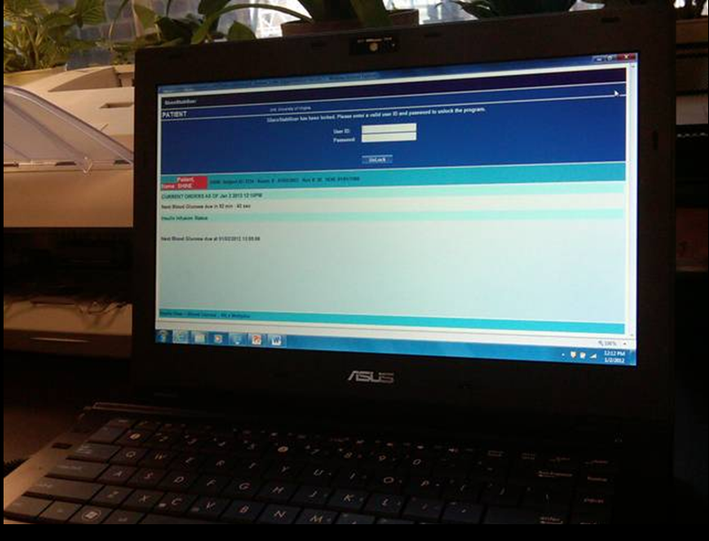
SHINE study laptop

Slide 9
Study treatment by group
 | Control Group (BG <180mg/dL) | Intervention Group (BG 80-130mg/dL)
IV Infusion | Normal saline | Human regular insulin
Subcutaneous Injections | Human regular insulin AND Basal insulin (Level 3 only) | Rapid acting analog insulin OR Normal saline
Hypoglycemia management (BG< 80 mg/dL) | D50 25 mL (½ amp) (per hypoglycemia protocol) | D50 individualized dose (per GlucoStabilizer)

Slide 10
Control group protocol

Slide 11
Control group overview
Target glucose <180 mg/dL
Q1 hr glucose checks for 1st 4 hrs
Q3 hr glucose checks per sliding scale schedule at 03:00, 06:00, 09:00, 12:00, 15:00, 18:00, 21:00 and 24:00
Sliding scale insulin if indicated ONLY at 06:00, 12:00, 18:00 and 24:00 (avoid stacking)
IV saline drip (to maintain blind)
Basal insulin (in consultation with study team & only at 48 hrs if pt requires more aggressive glucose control)
Study laptops display static protocol & used to record study glucose management

Slide 12
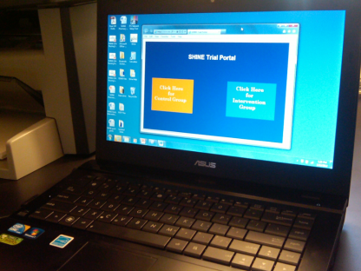
SHINE trial portal

Slide 13
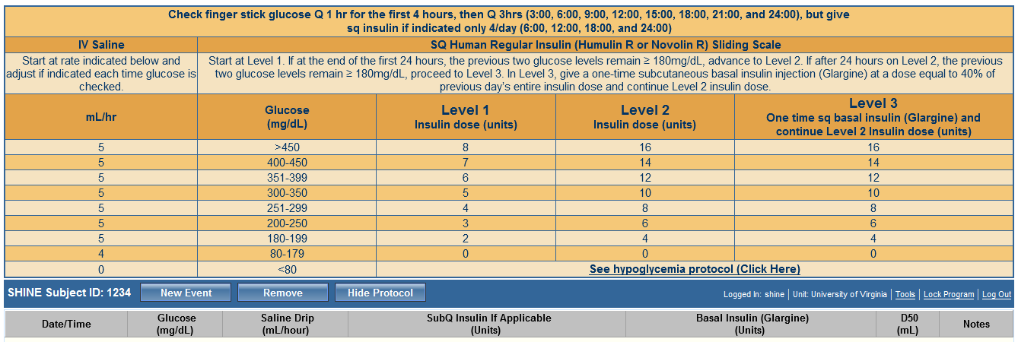
Control Treatment Screen
2
1
3

Slide 14
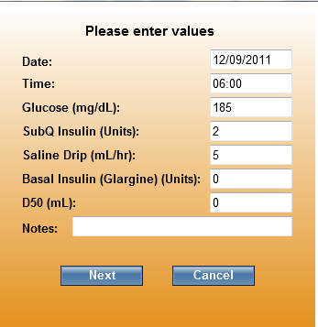
Control treatment screen

Slide 15
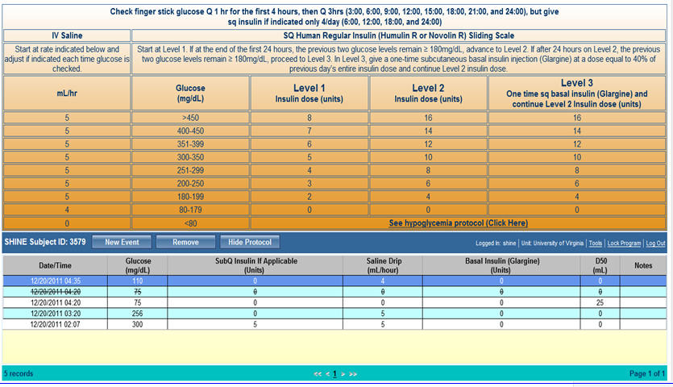
Control treatment screen

Slide 16
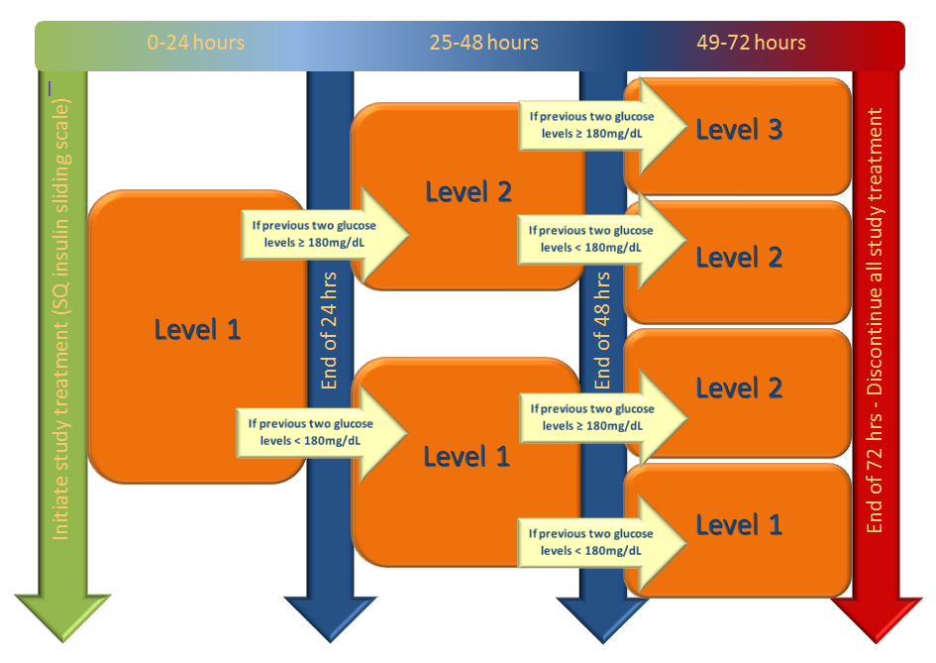
Control group – Levels of sliding scale
All patients will begin at Level 1 at the start of the study treatment period (time of randomization). At 24 and 48 hours, the previous two glucose checks and episodes of hypoglycemia during the previous 24 hours will be reviewed with the study team to determine the level for the next 24 hour period.

Slide 17
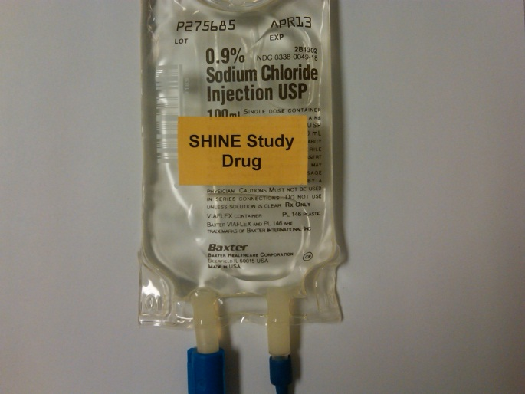
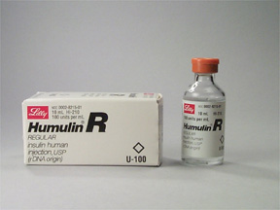
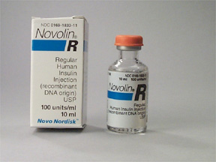
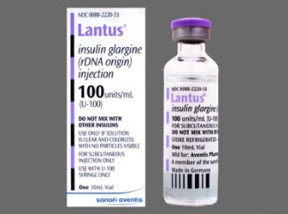
Control group – Study treatment
Control Group
IV infusion Normal saline Rate per sliding scale (continuous and adjusted at EACH glucose check)
Subcutaneous injections Human regular insulin Dose per sliding scale (@ 06:00, 12:00, 18:00 & 24:00) AND Basal insulin (Level 3 only) 40% of insulin requirement during previous 24 hrs (@ ~48 hrs)

Slide 18
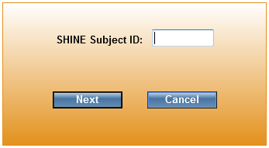
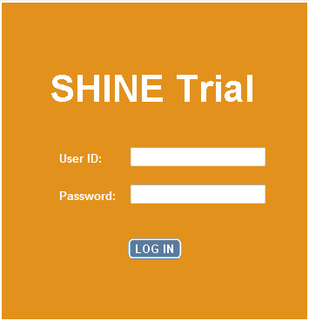
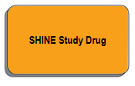
Control screens – Orange background

Slide 19
Intervention group protocol

Slide 20
Intervention group - Overview
Target 80-130 mg/dL
Glucose checks (~q 1-2 hrs)and IV insulin infusion adjustments per recommendation of GlucoStabilizer (computer decision support tool)
Count down clock and visual and auditory alerts at time of glucose level due
Subcutaneous meal insulin for PO pts
SQ saline for NPO or continuous tube feeds to maintain blind

Slide 21
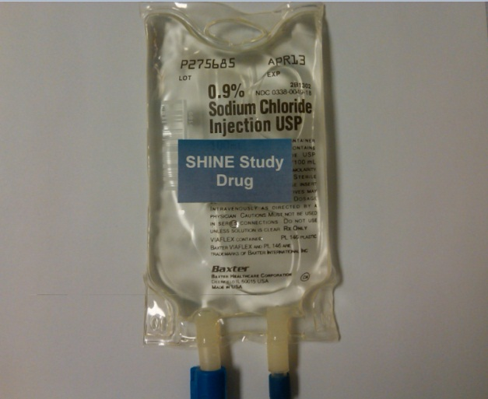
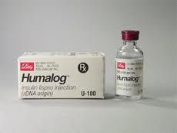
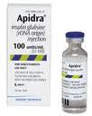
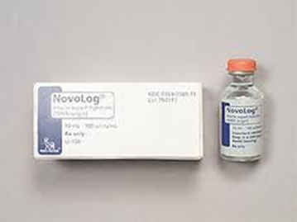
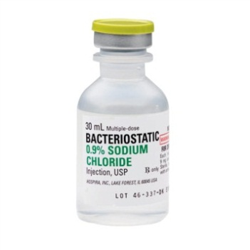
Study treatment - Intervention group
Intervention Group
IV infusion Human regular insulin (1:1) Rate per GlucoStabilizer (continuous)
Subcutaneous injections Rapid acting analog insulin (meal insulin) Dose per GlucoStabilizer @ ~06:00, 12:00 & 18:00 OR Normal saline 0.05 mL @ ~09:00 & 21:00

Slide 22
SHINE Trial Portal

Slide 23
Intervention group - GlucoStabilizer entry

Slide 24
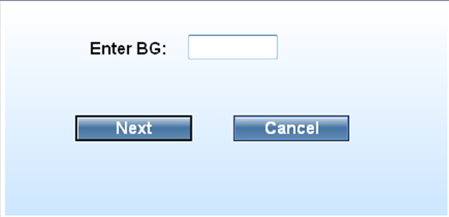
Intervention group - GlucoStabilizer entry

Slide 25
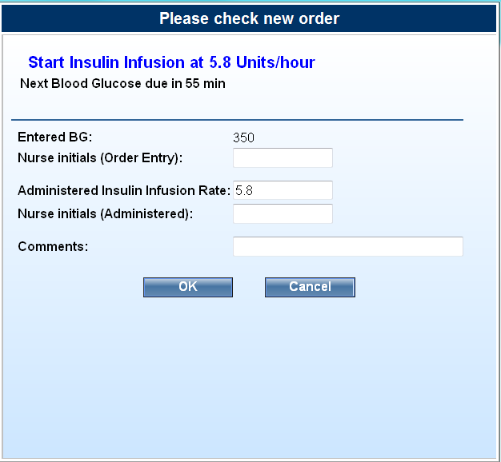
Intervention group GlucoStabilizer insulin dosing
Insulin dose = (BG – 60) * multiplier

Slide 26
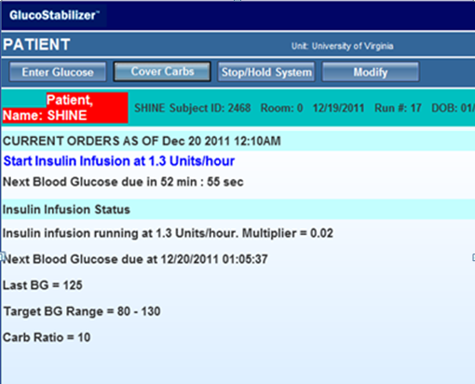
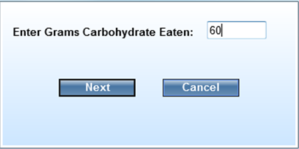
Intervention group Entering Meals in GlucoStabilizer
all or nearly all→ enter 60 grams
none or nearly none→ NO entry and NO meal insulin
Partial or in between → enter 30 grams

Slide 27
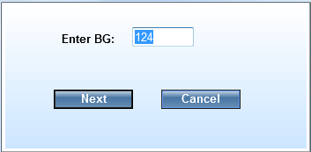
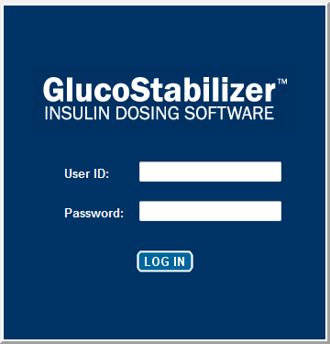
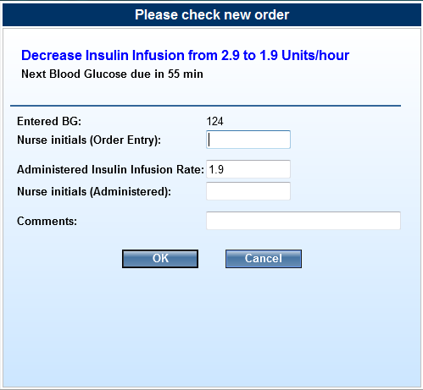
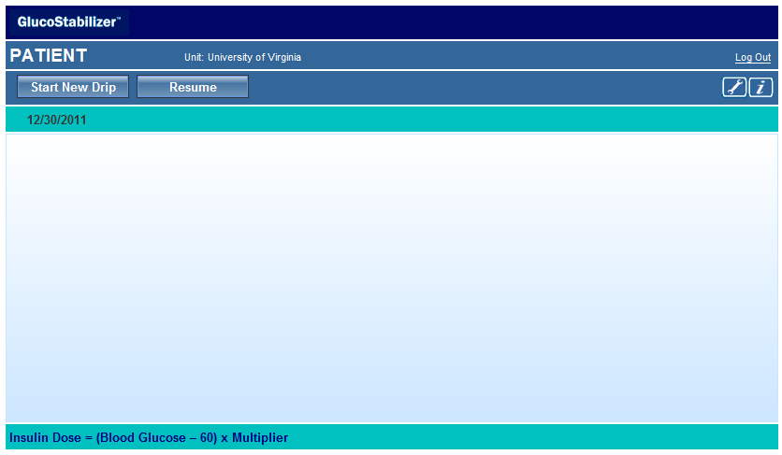
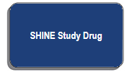
Intervention screens – Blue background

Slide 28
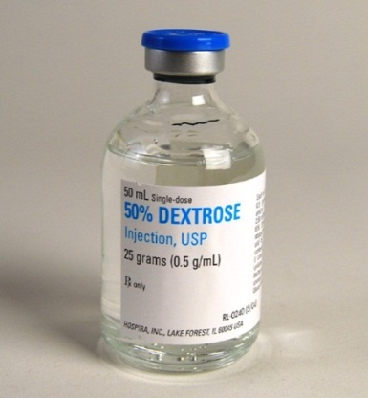
D50 for Hypoglycemia
SHINE hypoglycemia prevention and management protocol initiated when glucose <80mg/dL
D50 stored to allow immediate availability
Glucose <80mg/dL →
Control group – Give 25 ml (1/2 amp), recheck glucose q15min and repeat until glucose ≥ 80mg/dL
Intervention group - individualized dose and timing of glucose checks per GlucoStabilizer
Additional steps for glucose <70mg/dL

Slide 29
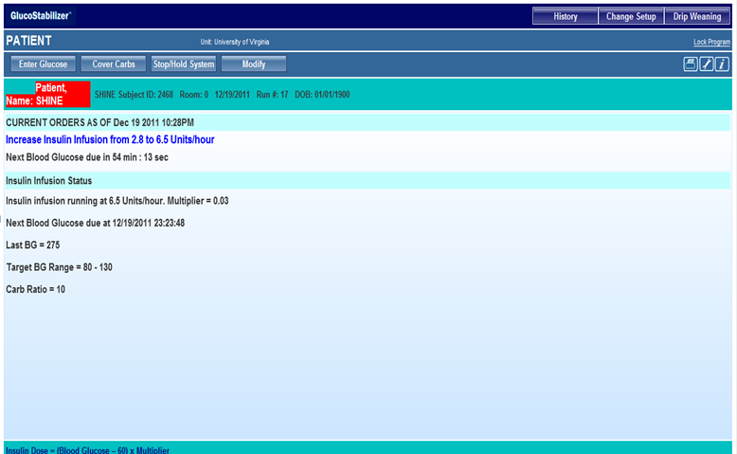
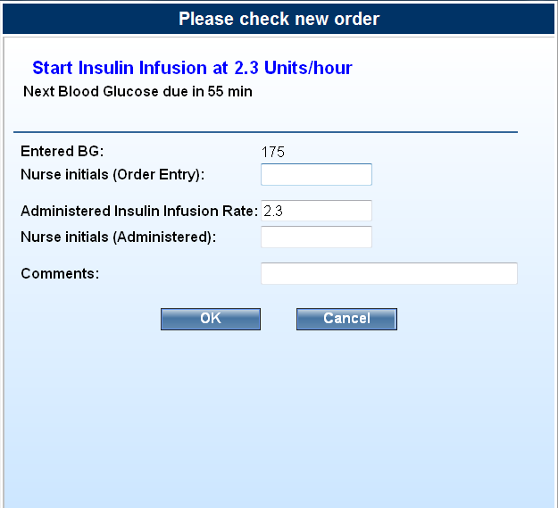
Standard clinical charting
Documenting study treatment
OR
AND

Slide 30
Maintaining the blind
IV infusion pumps - SHINE Study Drug
Subcutaneous injections – drawn up outside of view of patient/family
Study drug labeling
Study laptops – placement in room & ‘lock screen’ option
Conversations with study patient/family

Slide 31
Study considerations for nursing
Initiate treatment – drip and subcutaneous injections
Glucose checks per GlucoStabilizer or control sliding scale schedule
Review level change in control group
Meals - Consumption estimate & meal insulin dosing (intervention group only)
Maintain blind for patient and family

Slide 32
Study considerations for nursing, cont’d
Hypoglycemia prevention & management
D50 for hypoglycemia per GlucoStabilizer or control protocol & q15 min glucose checks when BG <80mg/dL
Additional steps if glucose <70mg/dL
Send serum glucose to lab
Hypoglycemia symptomatic questionnaire & neuro checks
Transition of care from shift to shift
Manage pauses in study treatment
Transition off study protocol

Slide 33
Study team contacts

Slide 35
 |  |  | SHINE TREATMENT GROUP
 |  |  | INTERVENTION GROUP | CONTROL GROUP
 | NUTRITIONAL STATUS | Eating PO meals or Bolus Tube Feeds | IV insulin plus Subcutaneous meal insulin injections How much IV Insulin? Per GlucoStabilizer recommendation How many units SQ meal insulin? Per GlucoStabilizer recommendation based on proportion of meal consumed given 20 minutes after start of meal 3x/day @ 0600, 1200, & 1800 | IV saline plus Subcutaneous sliding scale insulin injections How much IV saline? Per Sliding Scale Control Treatment Screen How many units SQ insulin? Per Sliding Scale Control Treatment Screen Finger stick glucose check @ 0300,0600,0900,1200,1500,1800,2100,2400 (Insulin dosing only @0600, 1200, 1800, & 2400)
 |  | NPO or Continuous Tube Feeds | IV insulin plus Subcutaneous saline injections How much IV Insulin? Per recommendation of GlucoStabilizer How much SQ saline? 0.05 mL of SQ saline @ time of glucose check nearest 0900 and 2100 | IV saline plus Subcutaneous sliding scale insulin injections How much IV saline? Per Sliding Scale Control Treatment Screen How many units of SQ insulin? Per Sliding Scale Control Treatment Screen Finger stick glucose check @ 0300,0600,0900,1200,1500,1800,2100,2400 (Insulin dosing only @0600, 1200, 1800, & 2400)

Slide 36
Control group details Q1 to Q3 hour checks
Do one check to start IV saline and check Q1 hr for next 4 hours
After 4th Q1 hr initiation glucose check, switch to Q3 hrs checks (3:00, 6:00, 9:00, 12:00, 15:00, 18:00, 21:00, and 24:00).
Skip 1st Q3 hr measurement if <1 hr after the previous measurement unless a scheduled dosing time

Slide 37
Control group details Meals and glucose checks
60 gram carbohydrate diet
Patients should eat only AFTER BG checked and SQ insulin has been given if indicated at 6:00, 12:00, and 18:00.
If a meal arrives before 6:00, 12:00, and 18:00, hold until AFTER glucose check and SQ insulin dose

Slide 38
Control group details Pauses in treatment protocol
When protocol is temporarily interrupted & clinical nurse cannot accompany the patient, stop IV saline drip.
If checks or SQ insulin injections were not missed, maintain schedule for checks & dosing. Restart IV saline @ next scheduled check.
If glucose checks or SQ insulin injections were missed:
Immediately check BG & resume IV saline
If scheduled SQ injection was missed, use BG to determine dose and give immediately
Return to schedule for glucose checks and SQ insulin dosing
Do not check BG <1 hr apart unless insulin dosing time
Do not give SQ insulin injections <3 hrs apart

Slide 39
Intervention group - Meals
60 gm carb per meal diet for PO & bolus tube feed pts
20 min after start of meal, clinical nurse will estimate meal eaten & enter in GlucoStabilizer (cover carbs)
GlucoStabilizer will recommend dose of SQ meal insulin
Remind patients not to eat extra meals and families not to eat from patient tray. Protocol approved snacks only.
NPO or continuous tube feed pts will receive normal saline injection (0.05mL) at ~09:00 and 21:00 after glucose check

Slide 40
Intervention group details Pauses in treatment protocol
When protocol is temporarily interrupted & clinical nurse cannot accompany, stop all study treatments.
When able to restart protocol, recheck glucose
Use result of glucose check to resume IV insulin drip
If <3 hrs, use “Resume” option in GlucoStabilizer
If ≥3 hrs, use “Start New Drip” option in GlucoStabilizer
If meal is eaten late, give SQ meal insulin w meal per protocol
If SQ saline dose was missed (NPO or cont tube feed pts)
Give 0.05 cc SQ saline
If next saline dosing time in <3 hrs, then skip it

Slide 41
Maintaining the blind Conversations with patients & families
Every patient in the study is getting insulin (study solution may be from shots or through IV or both) to treat high blood sugar.
All of the people who are taking care of you know exactly what treatments you are getting and are working to make sure your blood sugar is well managed.
For the study team to really be able to know which study treatment is best, it is important for you not to know which group you are in.
Whether you are in the study or not, we are making sure that we are treating your blood sugar when it is high or low.

